Slide 1


Aviation Safety and Risk Analysis
Identifying low-risk aircraft for strategic investment for Ndege Holding.inc

Slide 2
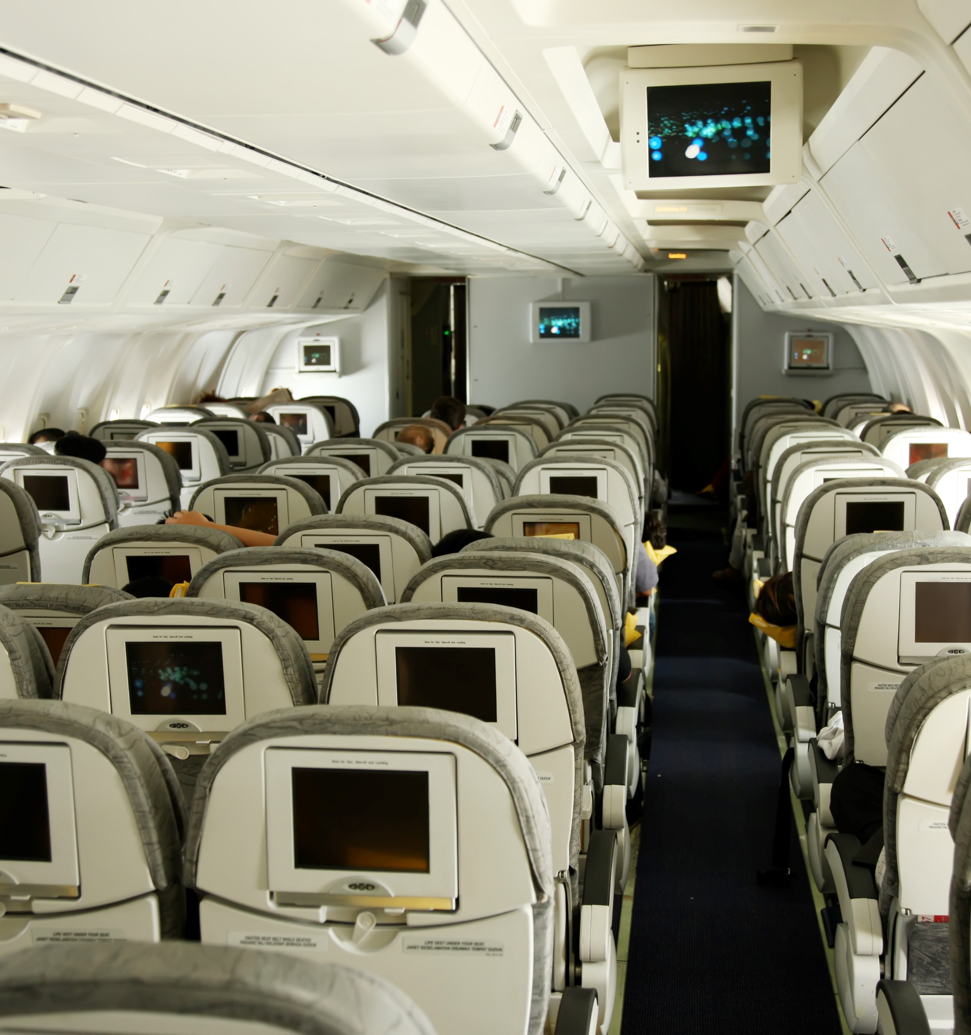

Presentation Outline
1
Overview and Business Understanding
2
Objectives of the Data analysis
3
Data Understanding and Cleaning.
4
Data Analysis
6
Key Insights
5
Conclusions and Recommendations

Slide 3

Overview and Business Understanding
Ndege Holding.Inc is expanding to aviation sector.
The board lacks experience in aviation safety and operational risk.
Poor aircraft selection could lead to increased accidents, financial losses, reputational damage, and higher insurance costs.
Analytical analysis aims to lead to informed decision making by identifying identifying historically safer aircraft options.

Slide 4



Objectives
Clean and prepare data to give accurate analysis
Quantify aircraft risk by defining measurable indicators (frequency and severity).
Compare and Identify low risk aircraft based on maintenance and safety performance
Visualize trends and insights for high level decision makers.
Translate analytical findings into actionable recommendations for aircraft acquisition decisions.

Slide 5

Data Cleaning
Loading data set: ‘flight.csv”
Methods:
Missing values
Duplicated values
Converting objects to integers/numeric
Creating data uniformity
Selecting key columns: ‘Type of aircraft, Year, Damage, Fatality”
Dropped of missing values

Slide 6
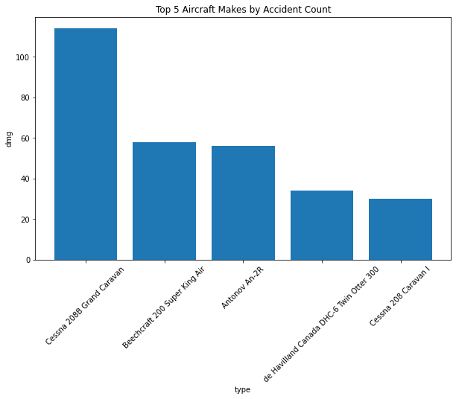
Top 5 Aircraft by accident count
Small sized aircraft types have higher fatality counts.
Have elevated safety risk compared to bigger size aircrafts.
Cessna 208B and Beechcraft 200 lead in total accidents.
Cessna 208 the last among the top 5 aircrafts.
Difficult to tell what the causes of the accident, whether its manufacturer, pilot error or lack of maintenance.

Slide 7

Top 5 Aircraft by Fatalities
Cessna 208B had the highest fatalities,
Cessna 208 the least among the top 5 aircrafts.
Small plains have many fatalities and lead in accident.
Big planes have less accidents, but catastrophic fatalities.
Many planes, high chances or probability of accidents.

Slide 8
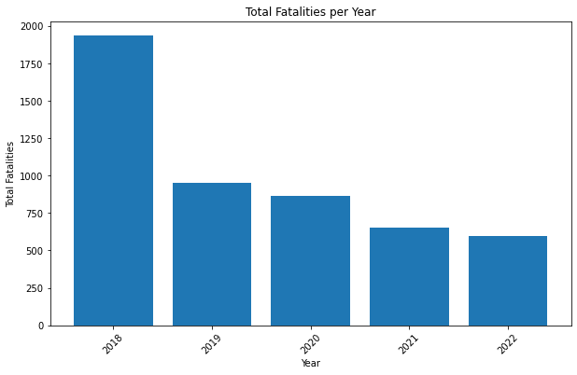
Total Fatalities per Year
Decreasing accidents fatalities from year to year .
Shows indications of increased aviation safety.
Important to find the reason for drastic fall in 2018-2019. COVID?

Slide 9
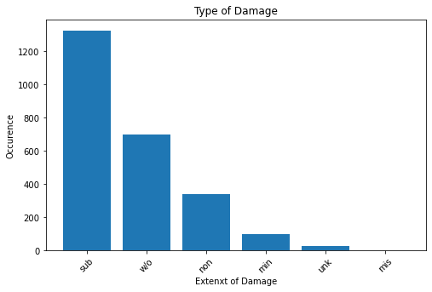
Type of Damage to the Aircraft
Most aircraft recorded substantial damage.
While almost as half were written off meaning total loss.
This is good information for risk and insurance calculation.
It’s difficult to know the causes or reason for damage.

Slide 10

Fatalities show patterns by aircraft type.
Fatality trends show a decline: aviation safety improvement, however outliers exist indicating persistent risk.
Aircraft type and accident counts not explicit indicator of faulty or bad aircraft.
Small aircraft sales are higher than big aircraft hence correlating to high number of accidents.
Aircraft operators practices and maintenance not factored in data

Slide 11

Recommendations
Prioritize aircrafts with low-risk fatalities and fewer accidents.
This offers a safer bet for entry point into aviation operations.
2. Develop a continuous aviation safety monitoring
Risk assessment should continue beyond acquisition.
3. More analysis is required;
Reason for declining fatalities and accidents over the years?
What's the causes of the accidents, manufacturer, pilot error or maintenance

Slide 12
Thank You
Questions?

